Slide 1
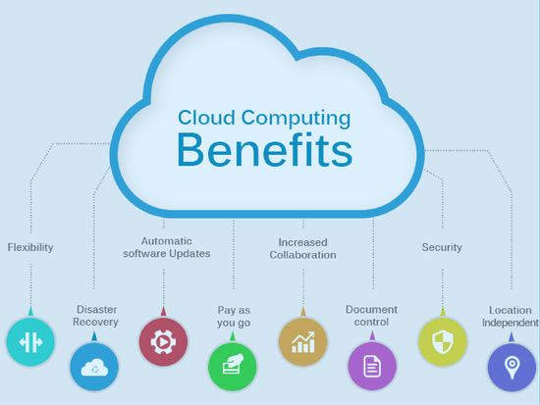
BENEFITS OF CLOUD COMPUTING
Here's a list of key benefits an enterprise can expect to achieve when adopting cloud infrastructure.
Efficiency / cost reduction
By using cloud infrastructure, you don't have to spend huge amounts of money on purchasing and maintain equipment. This drastically reduces capex costs. You don’t have to invest in hardware, facilities, utilities, or building out a large data center to grow your business. You do not even need large IT teams to handle your cloud data center operations, as you can enjoy the expertise of your cloud provider’s staff. Cloud also reduces costs related to downtime. Since downtime is rare in cloud systems, this means you don't have to spend time and money on fixing potential issues related to downtime.
2. Data security
One of the major concerns of every business, regardless of size and industry, is the security of its data. Data breaches and other cybercrimes can devastate a company's revenue, customer loyalty and brand positioning. Cloud offers many advanced security features that guarantee that data is securely stored and handled. Cloud storage providers implement baseline protections for their platforms and the data they process, such authentication, access control, and encryption. From there, most enterprises supplement these protections with added security measures of their own to bolster cloud data protection and tighten access to sensitive information in the cloud.
3. Scalability
Different companies have different IT needs -- a large enterprise of 1000+ employees won't have the same IT requirements as a start-up. Using cloud is a great solution because it enables enterprise to efficiently -- and quickly -- scale up/down their IT departments, according to business demands. Cloud based solutions are ideal for businesses with growing or fluctuating bandwidth demands. If your business demands increase, you can easily increase your cloud capacity without having to invest in physical infrastructure. This level of agility can give businesses using cloud computing a real advantage over competitors. This scalability minimizes the risks associated with in-house operational issues and maintenance. You have high-performance resources at your disposal with professional solutions and zero up-front investment. Scalability is probably the greatest advantage of the cloud.
4. Mobility
Cloud computing allows mobile access to corporate data via smartphones and devices, which is a great way to ensure that no one is ever left out of the loop. Staff with busy schedules, or who live a long way away from the corporate office, can use this feature to keep instantly up-to-date with clients and coworkers. Resources in the cloud can be easily stored, retrieved, recovered, or processed with just a couple of clicks. Users can get access to their works on-the-go, 24/7, via any devices of their choice, in any corner of the world as long as you stay connected to the internet. On top of that, all the upgrades and updates are done automatically, off-sight by the service providers. This saves time and team effort in maintaining the systems, tremendously reducing the IT team workloads.
5. Disaster recovery
Data loss is a major concern for all organizations, along with data security. Storing your data in the cloud guarantees that data is always available, even if your equipment like laptops or PCs, is damaged. Cloud-based services provide quick data recovery for all kinds of emergency scenarios -- from natural disasters to power outages. Cloud infrastructure can also help you with loss prevention. If you rely on traditional on-premises approach, all your data will be stored locally, on office computers. Despite your best efforts, computers can malfunction from various reasons -- from malware and viruses, to age-related hardware deterioration, to simple user error. But, if you upload your data to the cloud, it remains accessible for any computer with an internet connection, even if something happens to your work computer.
6. Control
Having control over sensitive data is vital to any company. You never know what can happen if a document gets into the wrong hands, even if it’s just the hands of an untrained employee. Cloud enables you complete visibility and control over your data. You can easily decide which users have what level of access to what data. This gives you control, but it also streamlines work since staff will easily know what documents are assigned to them. It will also increase and ease collaboration. Since one version of the document can be worked on by different people, and there's no need to have copies of the same document in circulation.
7. Competitive edge
Not every company will migrate to the cloud, at least not yet. However, organizations which adopt cloud find that many benefits that cloud offers positively impacts their business . Cloud adoption increases every year, since companies realize that it offers them access to world-class enterprise technology. And, if you implement a cloud solution now, you'll be ahead of your competitors.

Slide 2
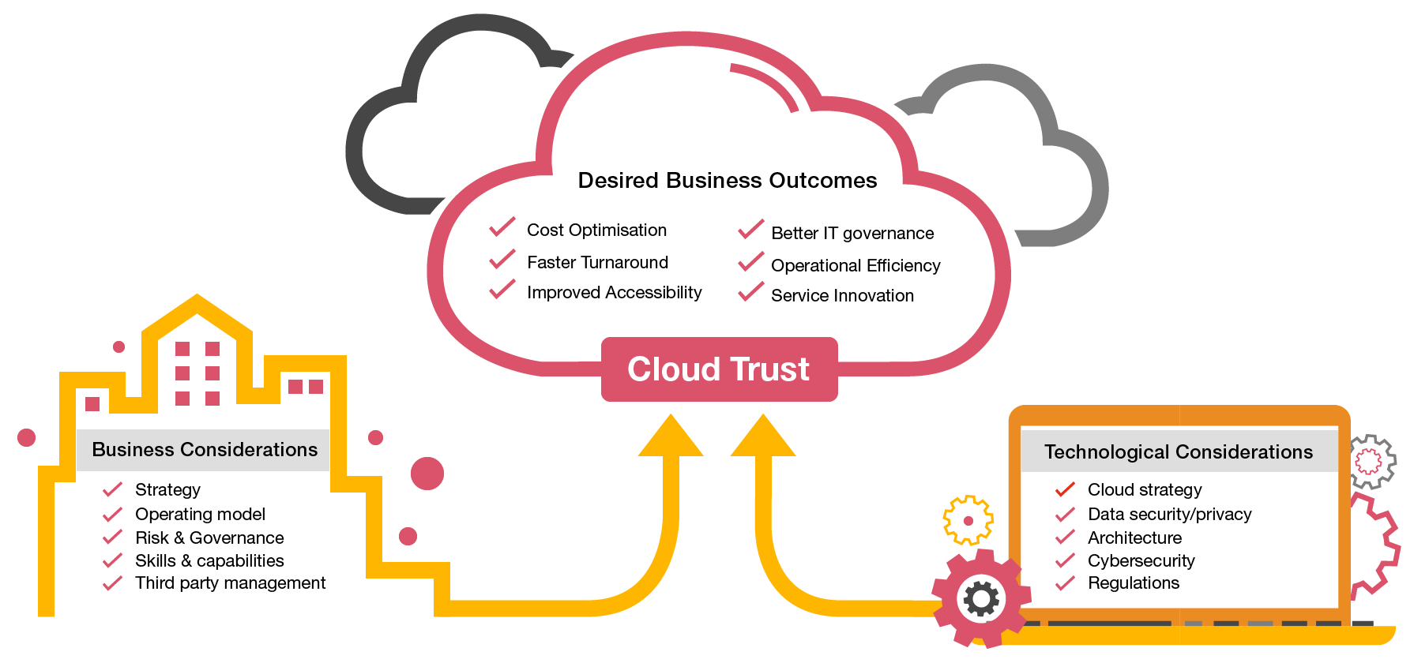
Cloud Risks and Considerations
Risks
1.The impact on a business return on investment (ROI)
Migration to the cloud might sound like the most cost effective option, but businesses should carefully compare the costs of owning software and equipment with the cost of "leasing" IT technologies. Parameters like speed, security, usage, quality of service, scalability and support must be considered. 2. Compatibility
Migration to the cloud might pose problems of compatibility with an existing IT infrastructure, or with a company security requirements and organizational policies. Pre-planning is once again crucial in considering all these aspects prior to committing to the change. 3. Trust
Not all providers are equal. Services through cloud computing may be interrupted by unforeseen events. Outages from a service provider, for example, can happen. Since providers are unable to guarantee no service disruptions will occur, data may not be available 24/7. In a disaster situation, communications may be slow or shut down for a period of time. Once again, a careful assessment of the cloud service provider is paramount. Businesses need to consider the risks associated with trusting all their operations to an external party and what would happen in case of default and interruption of service. What guarantees the cloud service provider offers if disaster strikes is what a business needs to consider. 4. Confidentiality
Probably the main concern, confidentiality is often mentioned as the reason for not embracing cloud computing. If a company's operations require the handling of sensitive data, the protection of these data becomes a priority and a concern. A business might not feel confident in sharing with an external party their vital information. Responsibility for a data leak could be hard to assign when data are handled and transmitted between two parties.
5. Compliance
There are risks involving non-compliance with existing policies and contractual obligations related to the handled data or the business operations. The legal implication of using an external IT provider should be carefully reviewed. 6. Security
Not just confidentiality, but the entire structure should be evaluated. Where's your data going to be stored? Who will have access to the information? What security measures and protection does the cloud provider offer? Is all information (even when non-sensitive) transmitted in unsecured plaintext or is it encrypted at all times? 7. Lack of control over performance
There is always the risk that the system quality may be inadequate or that a cloud service provider is unable to provide quality services at all times. It should be clear what guarantees the provider can offer in terms of systems performance and, especially, how prompt is its corrective action in case of a disruption of service. Not having direct access to the infrastructure means that a business must rely on the prompt action of the provider when something goes wrong. 8. Lack of control over quality
Many of these risks can be mitigated by careful planning and attention to details when drafting service contracts with cloud providers. For example, risks related to privacy and data confidentiality can be reduced by using hybrid cloud computing ? sharing only some resources but not relinquishing data control. Even Steve Wozniak, the co-founder of Apple, has expressed his not-so-flattering opinion, on the rising and widespread adoption of cloud computing. Wozniak forecasts many "horrible problems" that will derive from the use of cloud computing. He too points out the issue of lack of ownership of data and resources. He sees the lack of data control as a true concern and believes the problem will only spiral towards the worst as more and more resources are shared. Regardless of the risks and adverse opinions, however, it seems cloud computing will continue its growth. Only time will tell if the benefits of this IT revolution will outweigh for good the risks involved.
Considerations
1.Security
With cloud computing, you are entrusting the security of your mission sensitive data to a third party. The provider must be able to meet industry regulations and compliance needs. It is also equally important for them to be able to illustrate who has access to your data, and what systems, infrastructures and environments your data touches throughout its life-cycle.
2.Availability
How does the provider ensure up-time and data availability? The Service Level Agreement (SLA) can offer some insight into the provider’s capabilities. Keep in mind, however, that even SLAs that offer 100% guaranteed up-time may not provide the protection you need, as many are capped at the monthly service fee – an amount far less than the cost to the business if the service becomes unavailable or if data is lost.
3.Mobility
For many businesses, the adoption of a cloud computing solution is a multi-step process – one that begins with virtualization and colocation, and then transforms into a private and then public cloud solution. It is important to ensure that the provider offers physical colocation along with their cloud offerings. This allows for the seamless communication of data and applications across physical and virtual platforms.

